Slide 1

Late Loan Prediction
Predicting Loans that are Likely to be Late

Slide 2
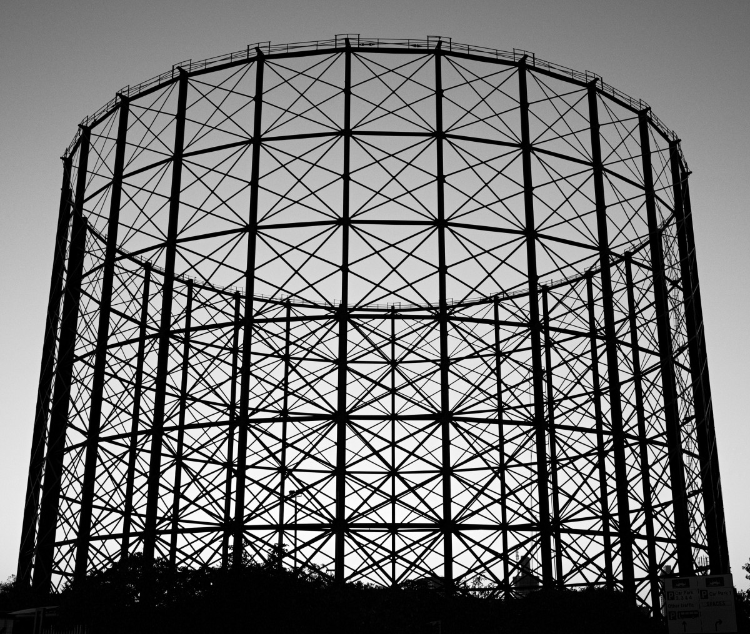
Structure
Problem Statement
01
The Dataset
02
Data Preparation
03
Interesting Insights
04
Hypothesis Tests
05
Modelling
06

Slide 3

1. Problem Statement: What’s the problem?
Bank issues a $10,000 loan to Youssef
Youssef’s credit score goes down
Bank is faced with unreturned money
Youssef makes some payments
Youssef suddenly cannot make payments
- Bad financial management
- Unexpected event
Everybody loses!

Slide 4
1. Problem Statement: Who benefits and How will the model help?
How will the model help?
Comparing profiles of past late loanees vs new loanees
Help raise early warning flags
Stop issuing loans to high risk profiles
Who Benefits?
Loan Issuing Institutions(Example: Banks)
Late loans is lost money
Loss on a balance sheet

Slide 5

2. The Dataset: Where From and What’s In It?
Where From?
LendingCLub (A Loan issuing institution)
Found on Kaggle (https://www.kaggle.com/wendykan/lending-club-loan-data)
What’s in it?
All Issued Loans (2007-2017)
Loan Description
Amount, Interest Rate, Term etc
Loanee Status
Employment, Debt-to-income, Home Ownership etc
Previous Loanee Financial Status
Bankruptcies, previous lateness etc

Slide 6
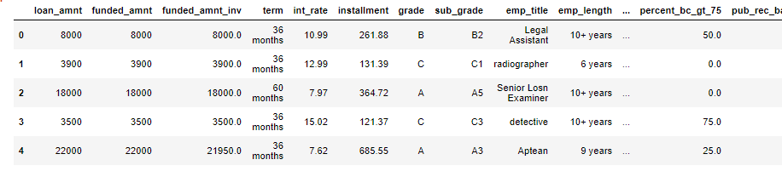
2. The Dataset: What does it look like?
2.6 million Loans (Rows)
145 Features(Columns) for Each Loan
Various datatypes:
Integers
Floats
DateTime
Objects

Slide 7

3. Data Preparation
How were null values dealt with?
Features with >75% null values were removed
Features with strings => Filled with ‘Not Given’
Features with floats/int => Filled with mean (or mean rounded to nearest int)
Features with sparse arrays(Mostly 0 & rarely 1,2 or 3) => Filled with 0. (eg Bankruptcies)

Slide 8
3. Data Preparation
How were datatypes managed?
Features containing dates were converted from objects to Time Stamps.
Integer/Floats changed from 64-bit to 32-bit to save on file size.

Slide 9
3. Data Preparation
How was the categorical feature (employment title) dealt with?
Initially:
Manually typed employment titles
420,000 unique entries
Problem for modelling
Now:
Converted all entries to lower case
Stripped of empty space for ease of grouping
Grouped into 12 labels (Executive, skilled, federal, other etc)

Slide 10
3. Data Preparation
How was the target variable made binary?
Initially:
9 unique labels (Varying form of good or bad)
Current, Fully Paid etc – The good ones
In Grace Period, Charged Off, 30+ days late etc – The bad ones
Now:
2 unique labels (Good/Bad)

Slide 11

4. Interesting Insights
Questions examined included:
How are loan amounts distributed?
How are interest rates distributed?
How does the term of the Loan affect loans?
Can we visualize Loan Amount, Interest Rate and Term into 1 graph?
How does the grade of the loan affect loans?
How have some features changed over time?
What’s the difference between good and bad loans regarding loan amounts and IR?

Slide 12
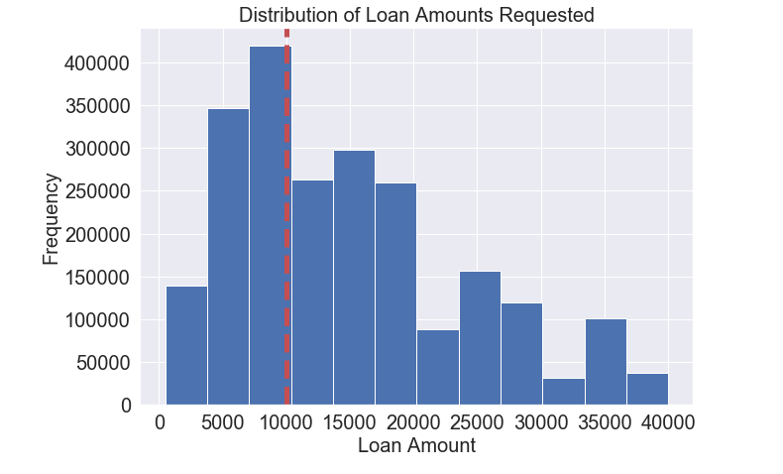
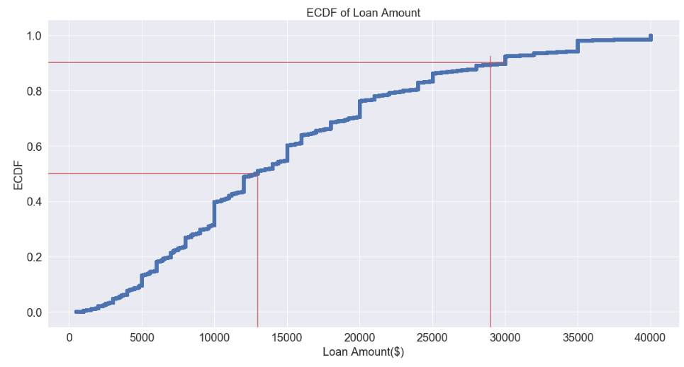
How are loan amounts distributed?
Skewed to the right
Most common loan is $10,000
50% of Loans < $13,000
90% of loans < $29,000
Largest loan $40,000
Lowest loan at $500.
Spikes at round values (10,000 ,20,000, 25,000)
The biggest spike at $10,000
90%
50%

Slide 13
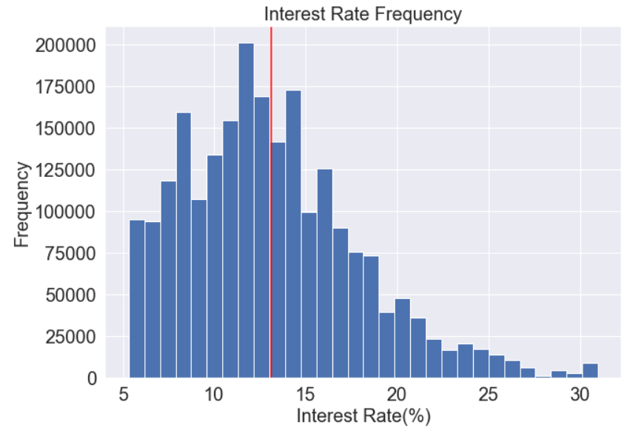
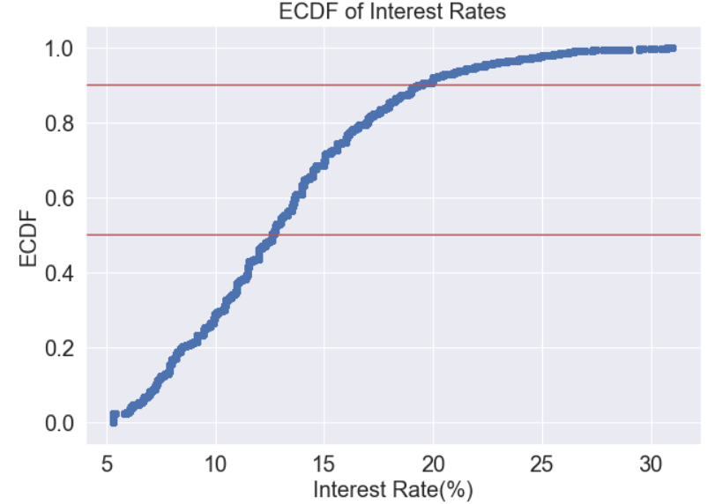
How are interest rates distributed?
Most common rate at 12-13%
Skewed to the right
50% of rates are ≤13%
90% of rates are ≤20%
Maximum rate at 33%
Minimum rate at 5%

Slide 14
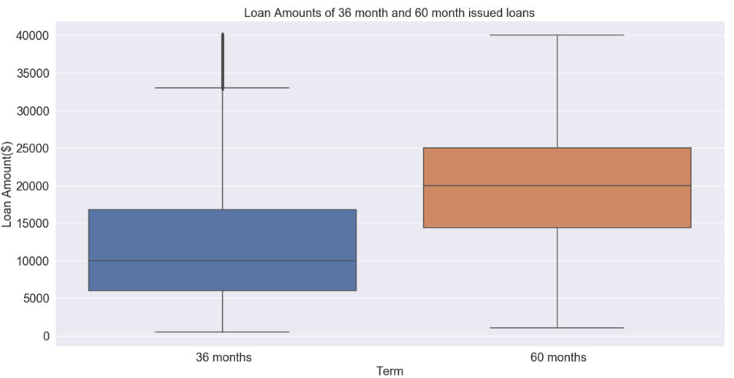
How does the term of the Loan affect loans(Amount)?
71% of all loans are 36 months
29% of all loans are 60 months
Mean for 60 months: $20,700
Mean for 36 months: $12,740
Both terms have an equal range
36 month IQR: $6,000 - $17,000
60 month IQR:$15,000 - $25,000

Slide 15
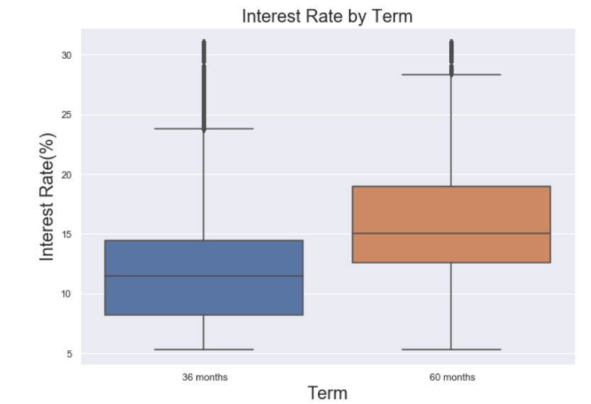
How does the term of the Loan affect loans (Interest Rates)?
36 months
IQR range: 7 =>14%.
Whisker edges range: 5% => 23%
Range: 5% =>33%
60 months
IQR range: 13% =>18%.
Whisker edges range: 5% =>27%
Range: 5% =>33%

Slide 16
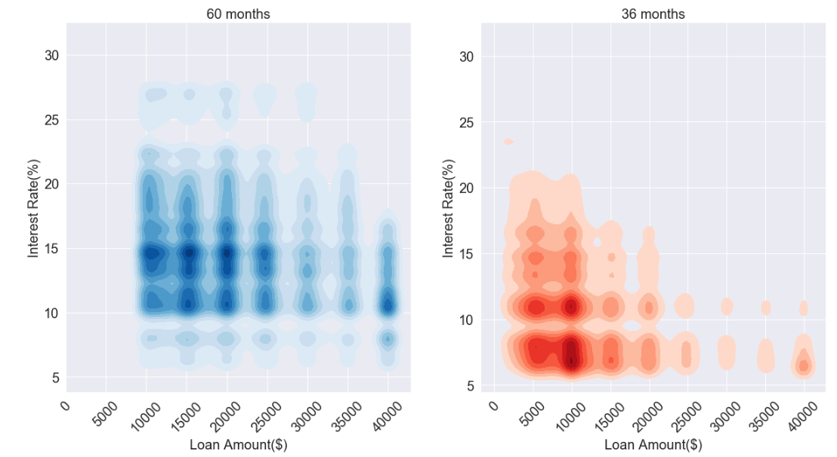
Can we visualize Loan Amount, Interest Rate and Term into 1 graph?
36 months
Loan concentrated between $8,000 & $12,000
Interest rates concentrated between 5% and 12%
Loans decrease after $20,000
60 months
Loans start at $9,000 .
Higher loan value, lower range of interest rate.
Loan concentrated between $10,000 & $20,000
Interest rates concentrated between 10% & 17%.
Higher loan amount, the lower the interest rate.
A $10,000 loan over 36 months has a lower interest rate than a $10,000 loan over 60 months.
Mean loan = $20,700, STD= $8,084
Mean interest rate of 15.9%. STD=4.9%
Mean loan = $12,740, STD= $8,600
Mean interest rate of 12%. STD=4.3%

Slide 17
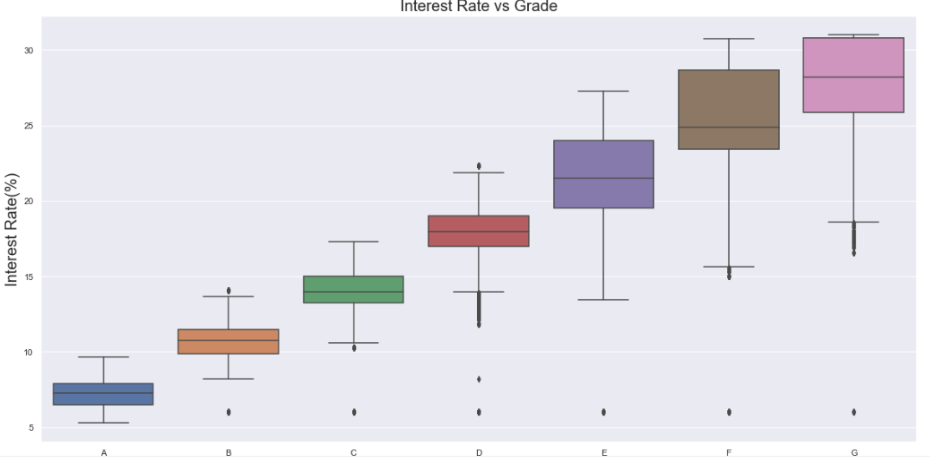
4. How does the grade of the loan affect loans?
High dependency
Higher IR for worse grades loans

Slide 18
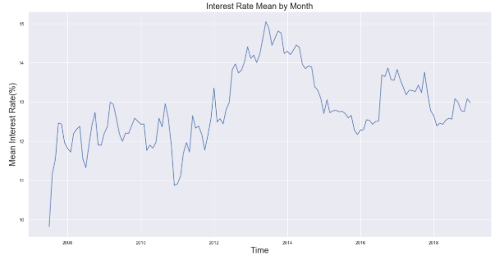
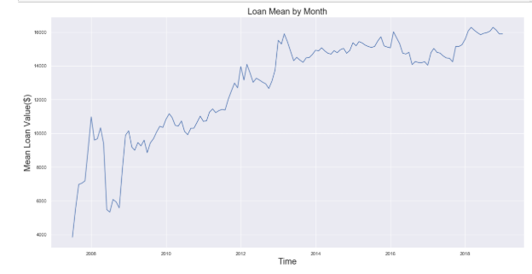
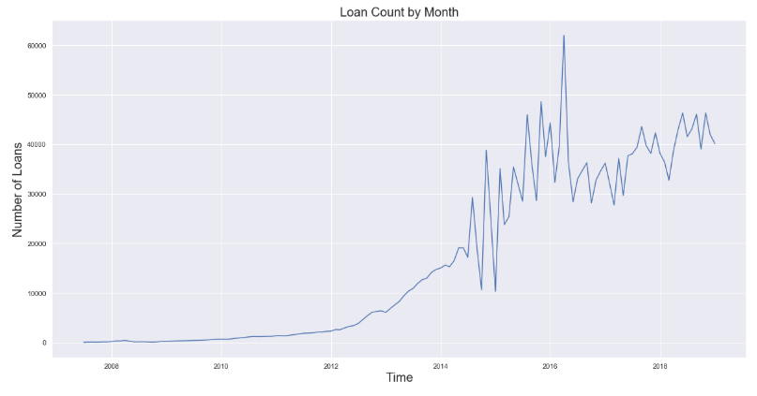
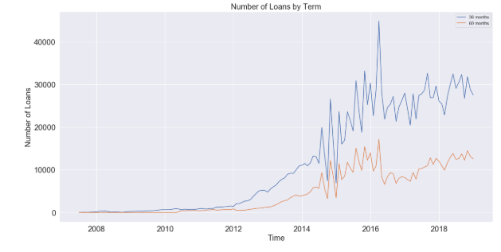
4. How have some features changed over time?

Slide 19
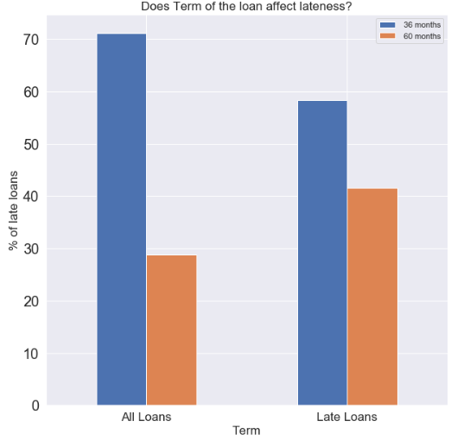
4. What’s the difference between good and bad loans regarding loan amounts and IR?
 | Average Loan Amount | Average Interest Rate(%)
Good Loans | $14,940 | 12.7%
Bad Loans | $15,700 | 15.7%
60 months
28% of all loans
42% of late loans.
36 months
72% of all loans
58% of late loans.
Loan amount, interest rate and term of loan does affect the lateness of the loan

Slide 20
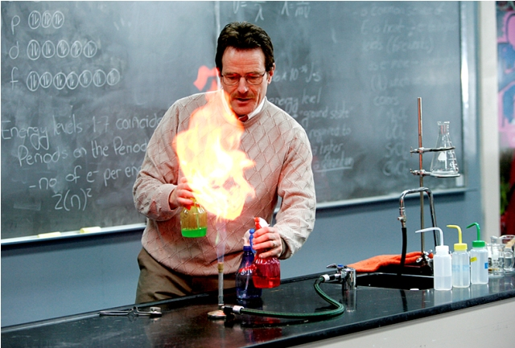
5. Hypothesis Tests
Four hypothesis tests
Four interesting questions
Do mortgage holders have different interest rate distribution vs home owners?
Do mortgage holders have different distributions of loans vs those who rent their homes?
Is interest rate distribution the same for all loan Status (Bad vs Good)?
Is loan amount distribution the same for all loan Status (Bad vs Good)?

Slide 21
5. Hypothesis Tests
State null hypothesis and find observed difference of means
Combine the two datasets
Scramble the data so order is lost
Permutated samples: Divide scrambled data into 2 sets. (Each same length as original sets)
Find permutated replicate (The replicate is difference of means)
Compute 2,000 replicates.
Run test to compute p-value. (Probability of observing a statistic ≥ than the one observed, given that null hypothesis is true)

Slide 22
5. Hypothesis Tests
Do mortgage holders have different interest rate distribution vs home-owners?
Null Hypothesis: Mortgage Holders and Owners have the same interest rate distribution
Observed Difference of Means | 0.38%
P-value | 0
Hypothesis Test | Reject the Null Hypothesis
Conclusion | Mortgage Holders and Owners do not have the same interest rate distribution

Slide 23
5. Hypothesis Tests
Do mortgage holders have different distributions of loans vs those who rent their homes?
Null Hypothesis: Mortgage Holders and Renters have the same loan value distribution.
Observed Difference of Means | $3495
P-value | 0
Hypothesis Test | Reject the Null Hypothesis
Conclusion | Mortgage Holders and Renters do not have the same loan value distribution

Slide 24
5. Hypothesis Tests
Is interest rate distribution the same for all loan Status (Bad vs Good)?
Null Hypothesis: Bad and Good Loans have the same interest rate distribution.
Observed Difference of Means | 3%
P-value | 0
Hypothesis Test | Reject the Null Hypothesis
Conclusion | Bad and Good Loans do not have the same interest rate distribution

Slide 25
5. Hypothesis Tests
Is loan amount distribution the same for all loan Status (Bad vs Good)?
Null Hypothesis: Bad and good Loans have the same loan amount distribution.
Observed Difference of Means | $749
P-value | 0
Hypothesis Test | Reject the Null Hypothesis
Conclusion | Bad and Good Loans do not have the same loan amount distribution

Slide 26
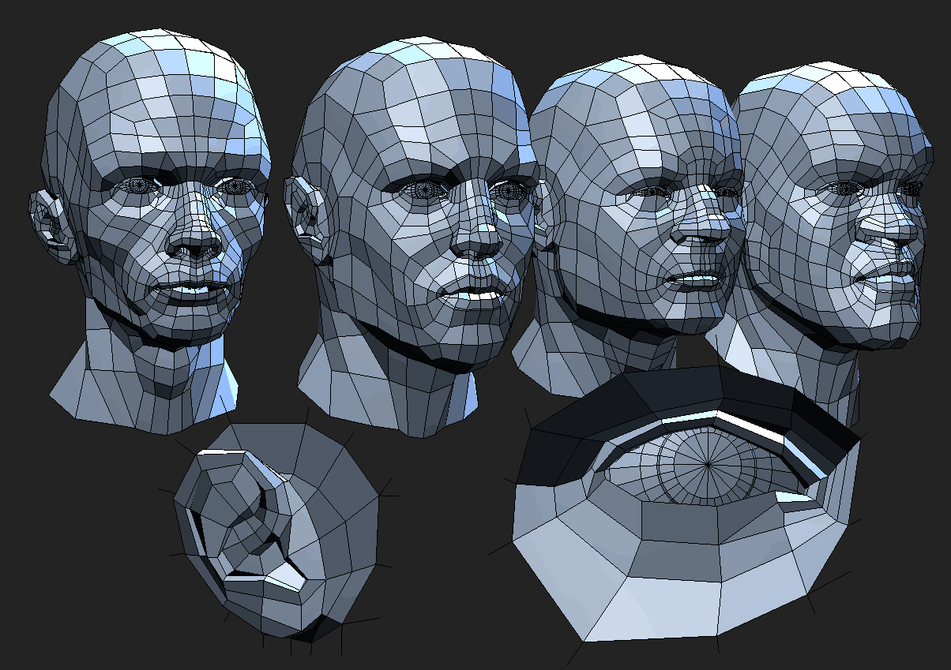
6. Modelling
3 Classification models used:
Logistic Regression
Random Forest
XG Boost

Slide 27
6. Modelling – Data Sets
3 Sets of Data
Training Set – Fit models
Validation Set – Compare results from models
Testing Set – Model performance based on selected model

Slide 28
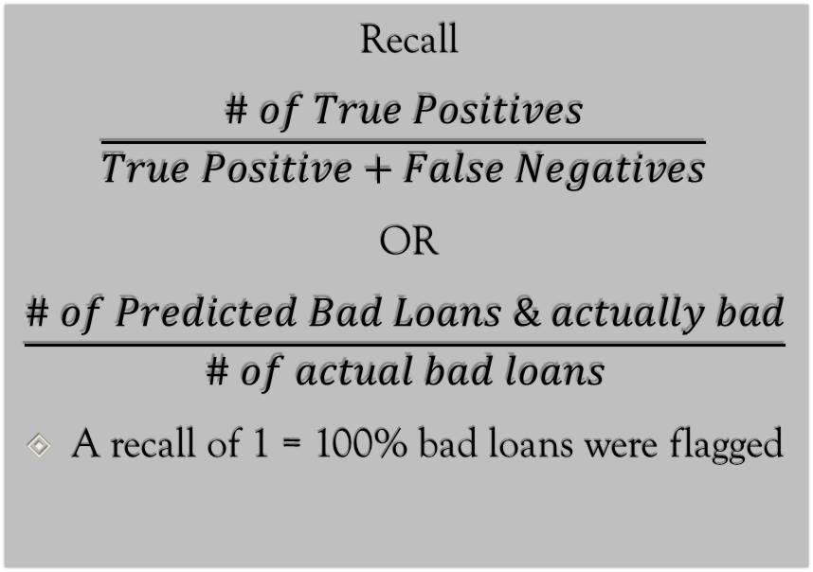
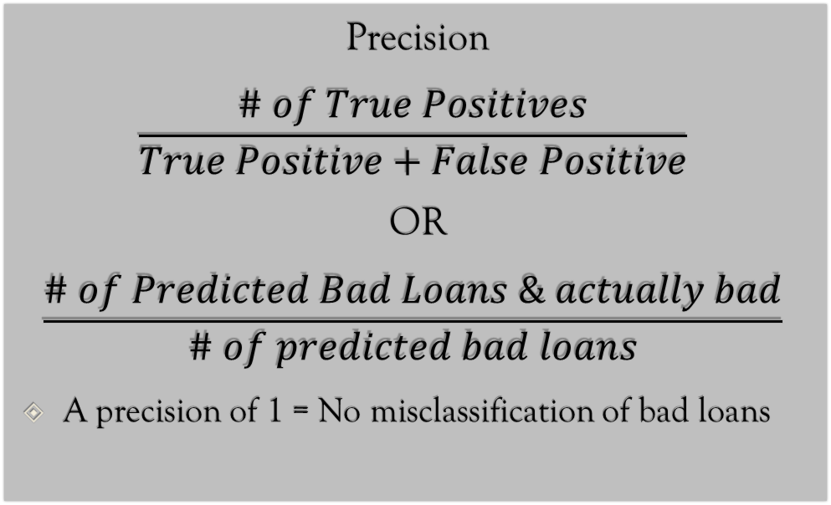
6. Modelling – Model Score
Recall
$$\frac{\# of True Positives}{True Positive+False Negatives}$$
OR
$$\frac{\# of Predicted Bad Loans \& actually bad}{\# of actual bad loans}$$
A recall of 1 = 100% bad loans were flagged
Precision
$$\frac{\# of True Positives}{True Positive+False Positive}$$
OR
$$\frac{\# of Predicted Bad Loans \& actually bad}{\# of predicted bad loans}$$
A precision of 1 = No misclassification of bad loans

Slide 29
6. Modelling – Model Score
Precision closest to 1 is important
Misclassification can lead to flagging customers that are okay -> Inconveniant
Recall greater than 0.8 is acceptable
80% of bad loans will be flagged

Slide 30
6. Modelling – Logistic Regression
Parameters to tune:
C – Inverse Regularization Parameter
Penalty – L1 or L2
Best Model:
C = 1
Penalty = L2
Results:
Precision = 0.99
Recall = 0.88

Slide 31
6. Modelling – Random Forest
Parameters:
Results:
Precision = 0.99
Recall = 0.78
Parameter | Description | Best Parameters
max_depth | Depth of each tree in forest | 29
max_features | Maximum features allowed to try in one tree | Sqrt
n_estimators | number of trees in the forest | 56

Slide 32
6. Modelling – XG Boost
Parameters:
Results:
Precision = 0.99
Recall = 0.86
Parameter | Description | Best Parameters
max_depth | Depth of each tree in forest | 61
max_features | Maximum features allowed to try in one tree | 22
n_estimators | number of trees in the forest | 771
Learning_rate | Loss function optimizer | 0.019
Colsample_by_node | subsample ratio of columns for each node | 0.4

Slide 33

6. Modelling – Summary and Winner
Logistic Regression is the winner with a recall score of 88%.
Results on test set:
Recall: 88%
Precision: 99%

Slide 34

6. Steps Forward
Use a larger RAM to test on more data
Test more models such as SVM

